Slide 1


NewLang Compiler Analysis
Project for the Software Depenability course
Student:
Angelo Afeltra
Teacher:
Prof. Dario Di Nucci
A.A. 2022/2023
Notes:
Hi, I am Angelo Afeltra and today I tell you about the analysis conduced on the NewLang Compiler project

Slide 2


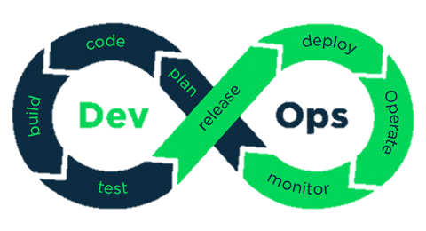



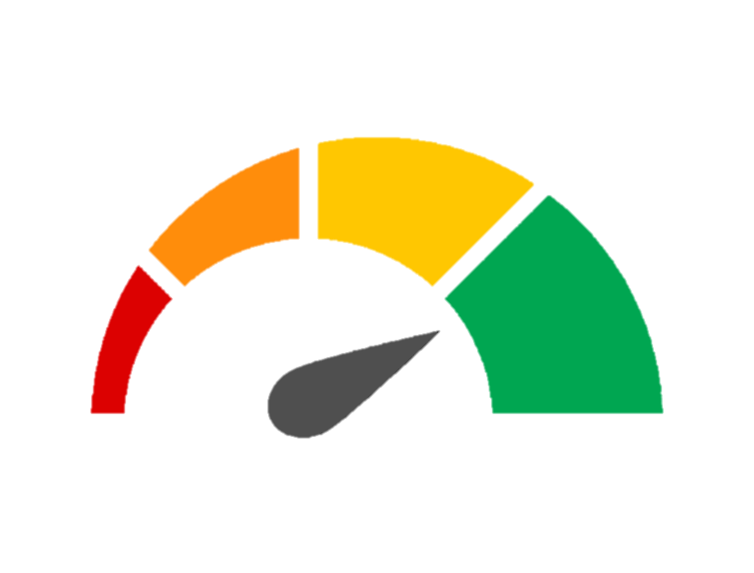



Continuous Integration Pipeline
CI
Notes:
Before starting the analysis activity, a Coninuos Integration pipeline was created by exploiting the GitHub Action, integrating the Maven Build, SonarCloud Analysis and docker image push tu docker hub.

Slide 3

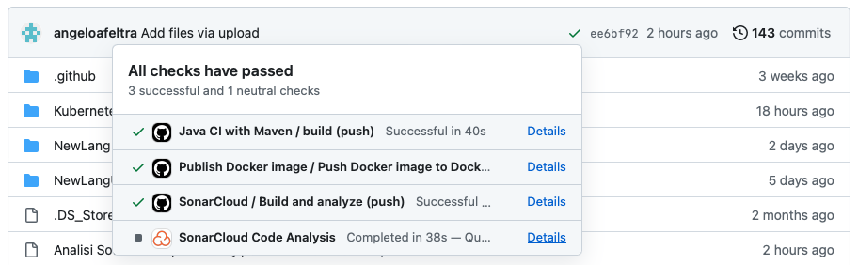
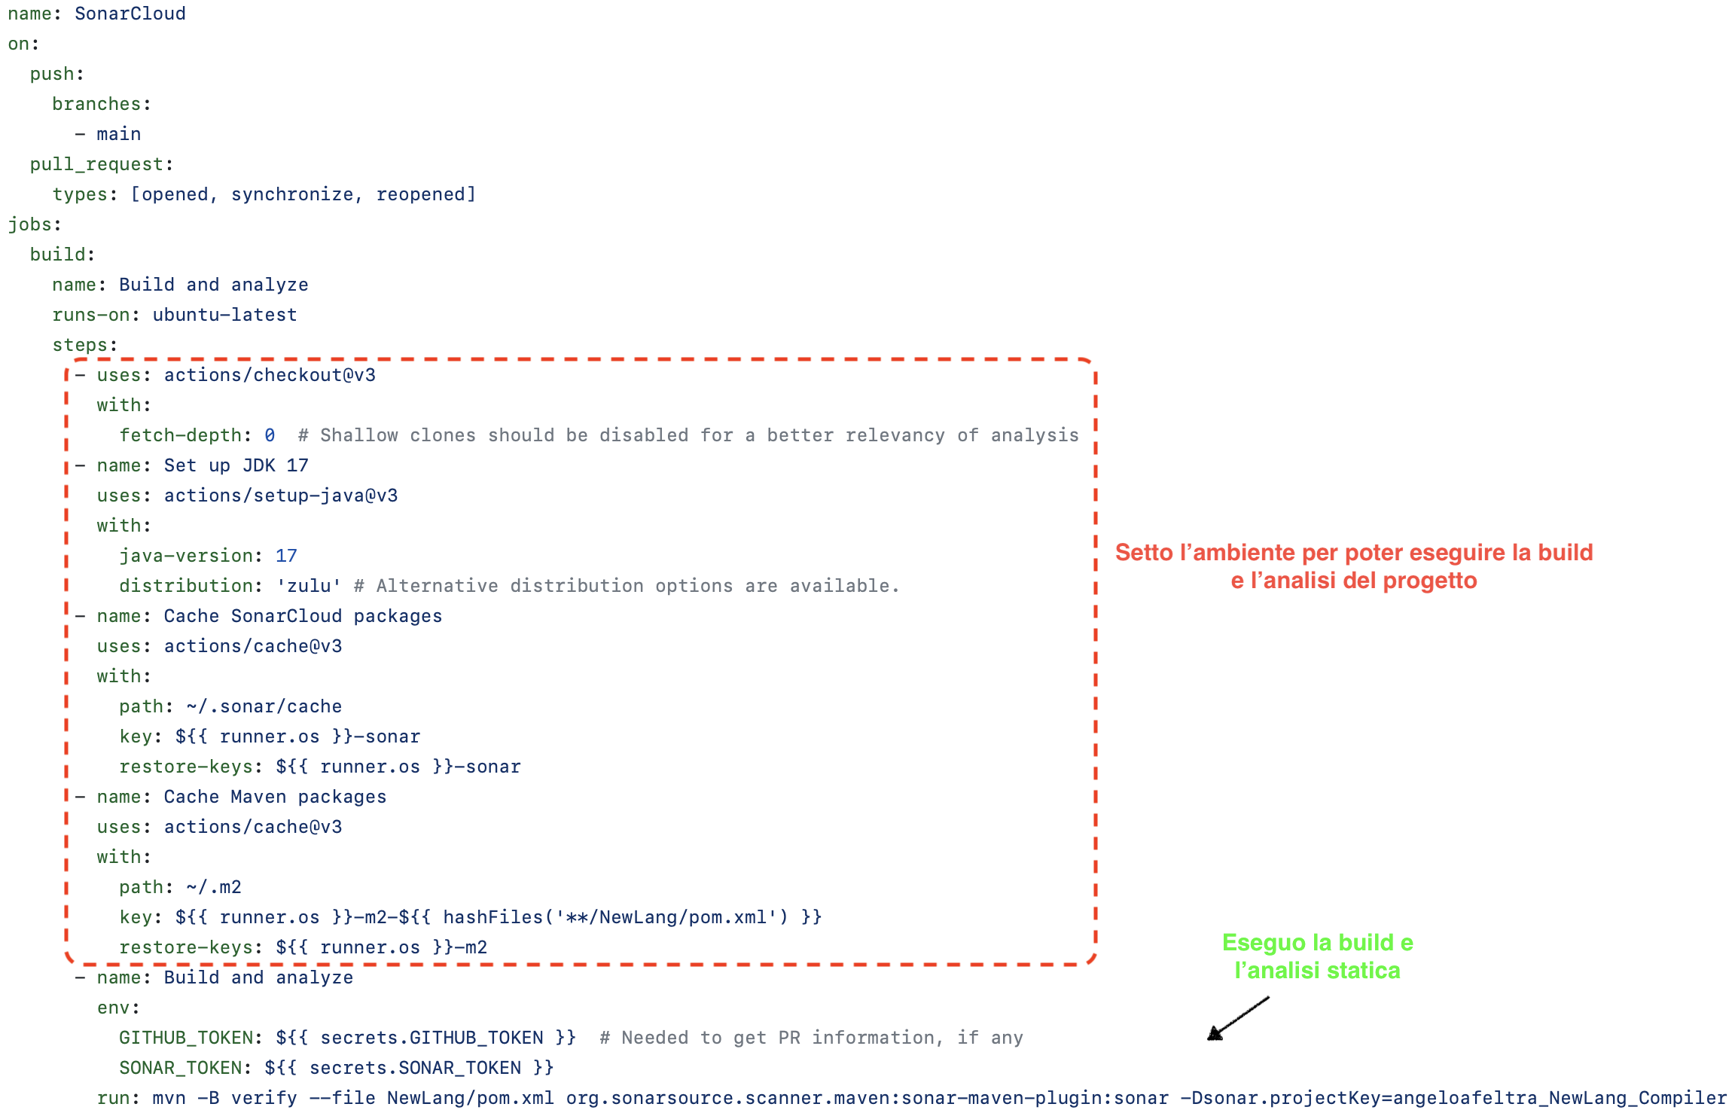
CI
Exemple
GitHub Action
For SonarCloud
Notes:
This is an exemple of GitHub Action that starts the sonarcloud analysis. In which the environment is first set up to run the build and after start the static analysis,

Slide 4
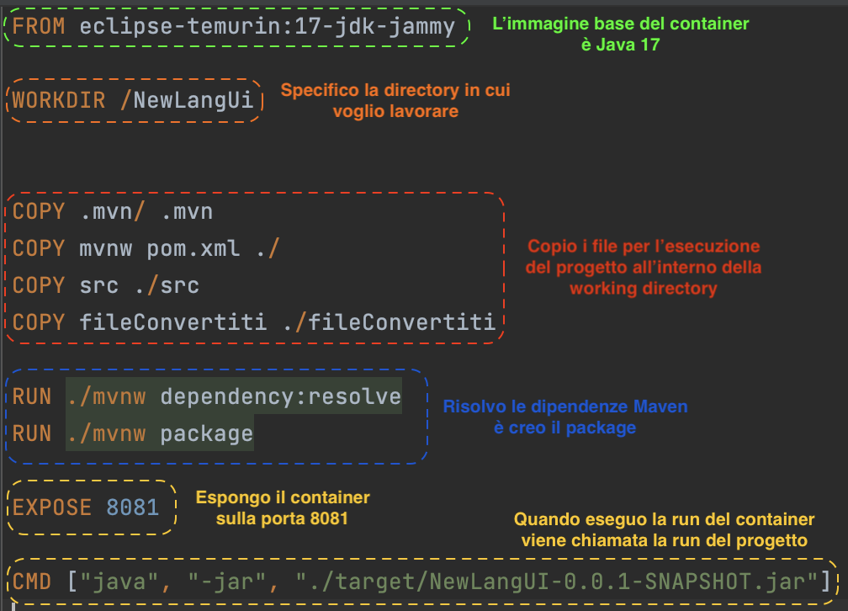
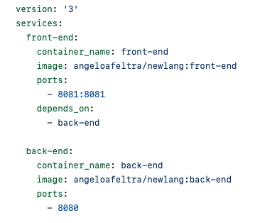
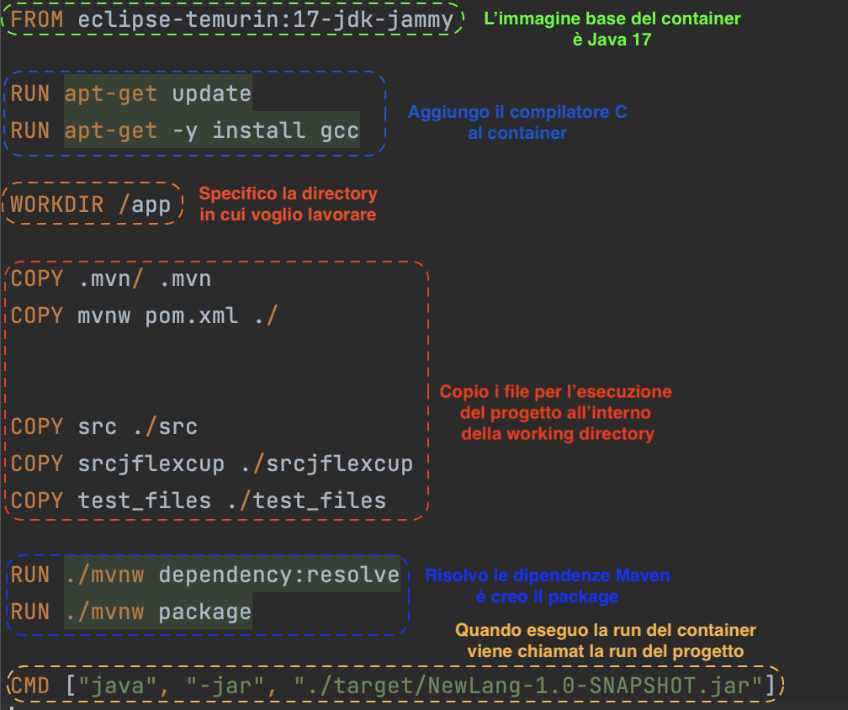
CI
DockerFile Front-End
Docker Compose
DockerFile Back-End
Notes:
For docket integration, the system was first containerized by creating a docker file for each services. After the docker image are pushed to DockerHub and by running the docker compose they will called up.

Slide 5
SonarCloud Analysis
CI
545
Issues
4
Bugs
4 Vulnerabilities
4
Security Hotspots
533
Code Smells
Notes:
Sonarcloud detected 545 issues, splitted into 4 bugs 4 vulnerabilities 4 security hotspots and 533 code smells.

Slide 6
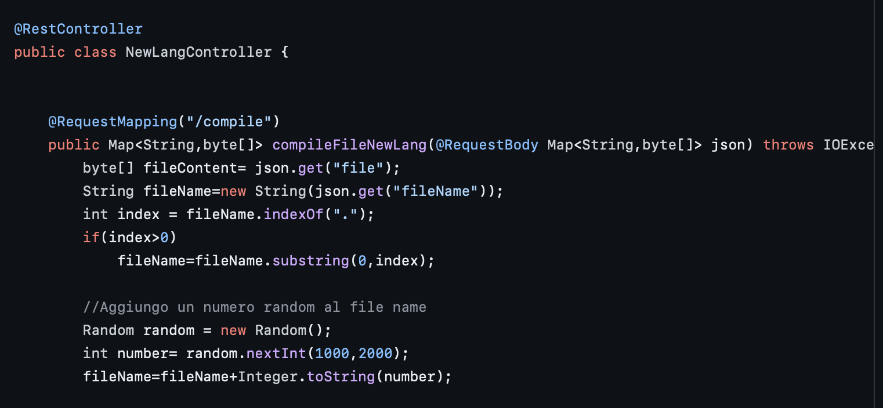
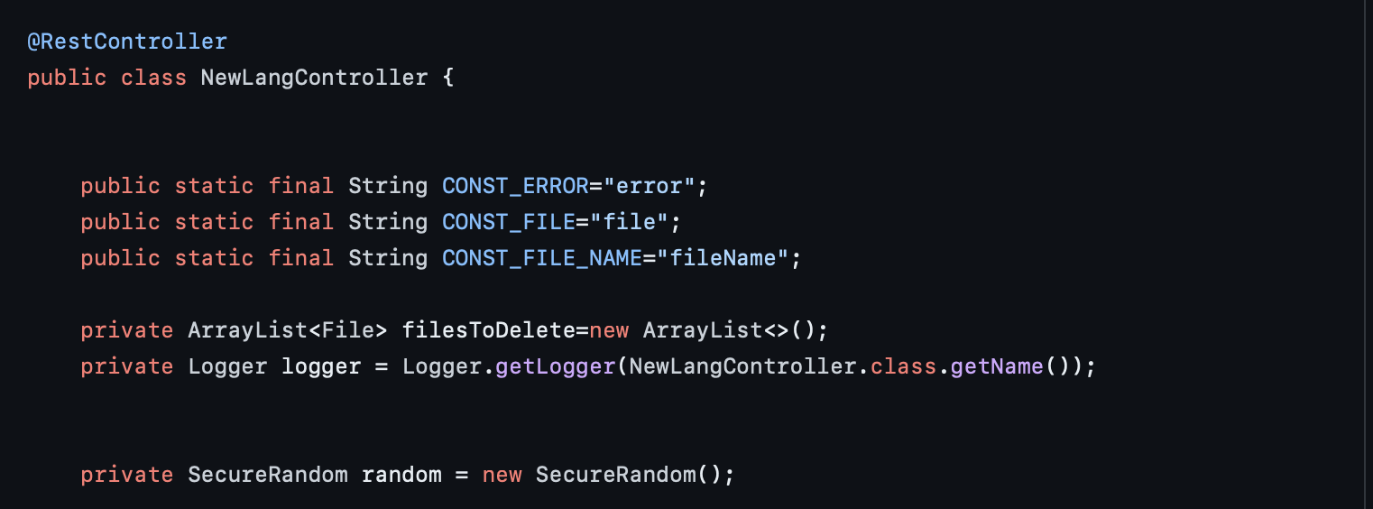



CI
Exemple Bug
Bug Fixed
Notes:
An exemple of bugs is the instantiation of a Random object within the compileFileNewLang method. Creating the object every time a random number is needed is inefficient and can produce numbers that are not random according to the JDK.
This bug has been fixed by making the Random object attribute of the class

Slide 7
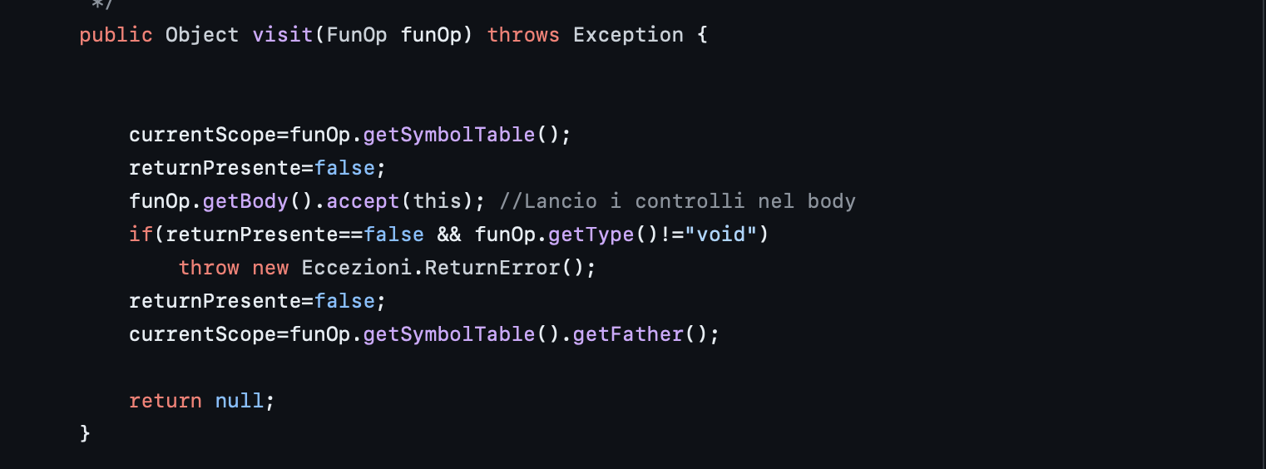
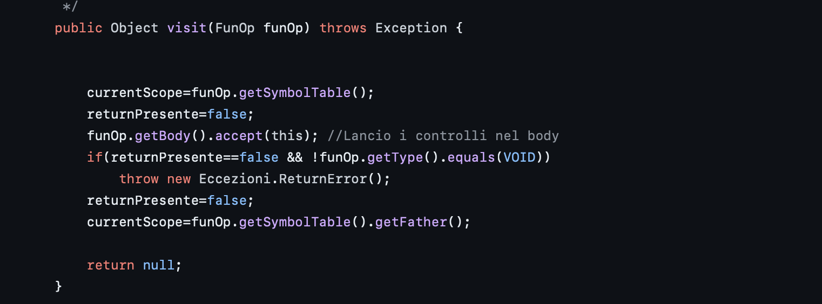
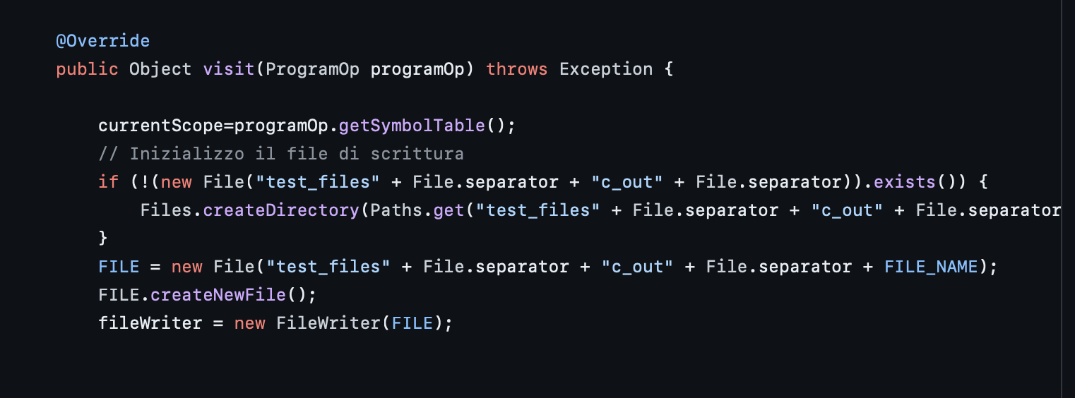




CI
Bug Type 1
Bug Type 2
Bug Type 3

Slide 8
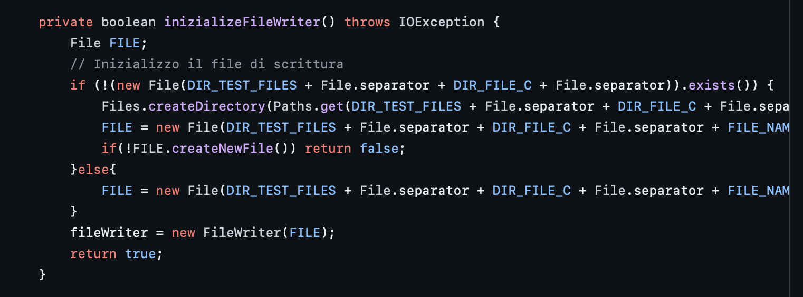




CI
Fix
Bug Type 1
Fix
Bug Type 2
Fix
Bug Type 3

Slide 9
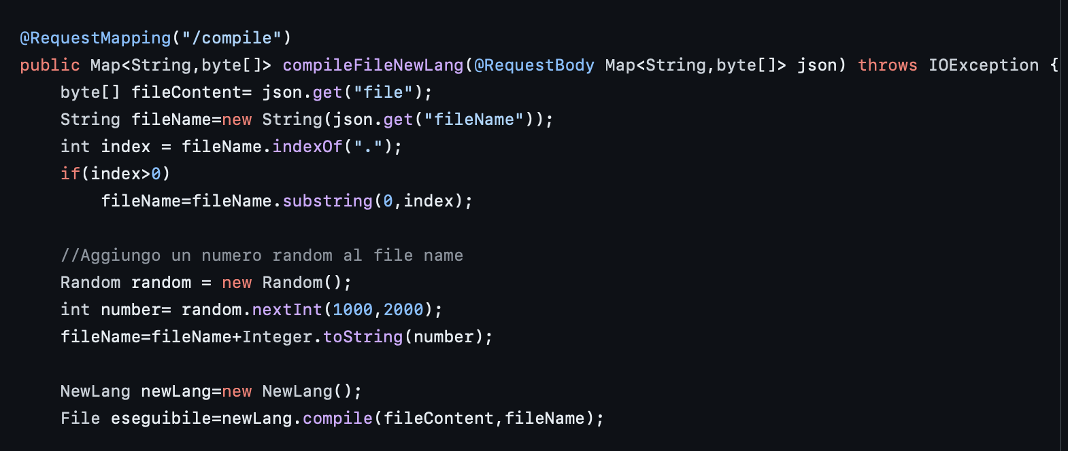
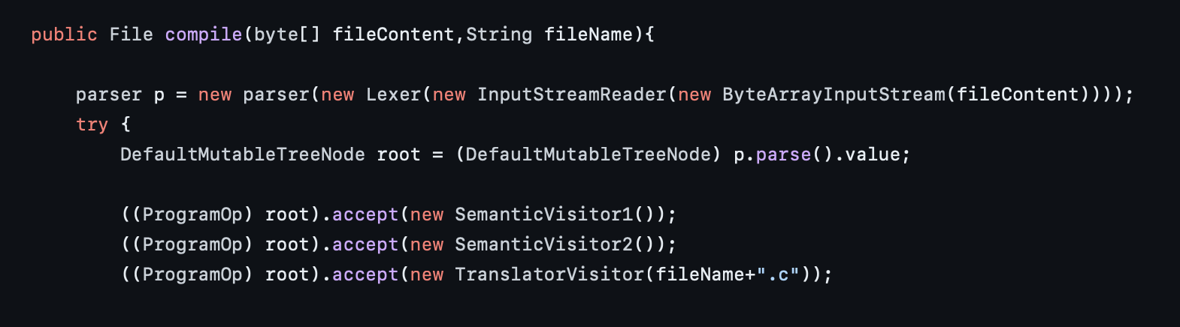
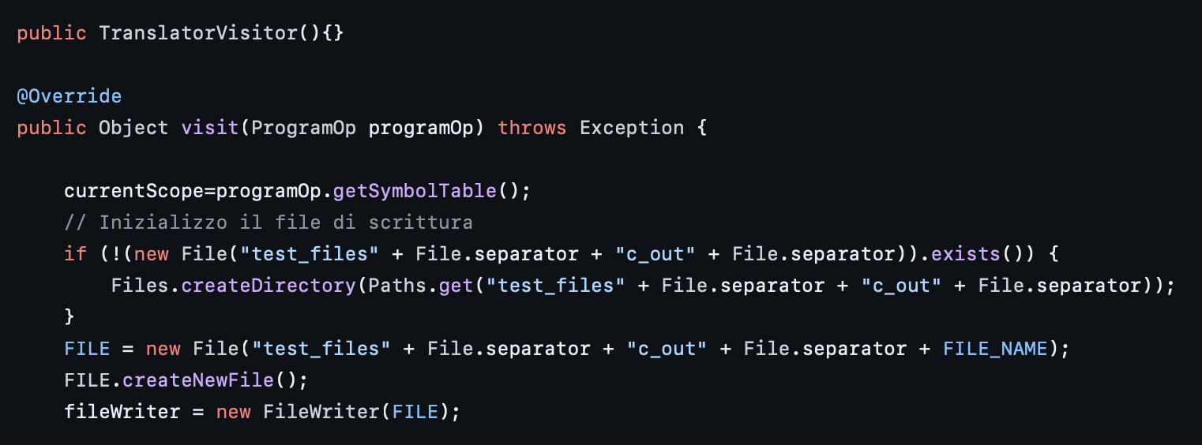
CI
Path-Injection
Vulnerability
Notes:
For the vulnerabilities, they all have a common root-cause. The Path-Inject. Looking at this execution flow, we can see how the compileFileNewLang method receives the name of the file to be converted and which is reused to generate the C file to be compiled. By exploiting this flow, important files on the system can be modified or deleted.

Slide 10
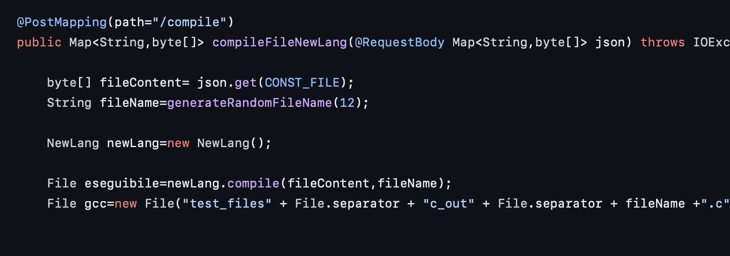
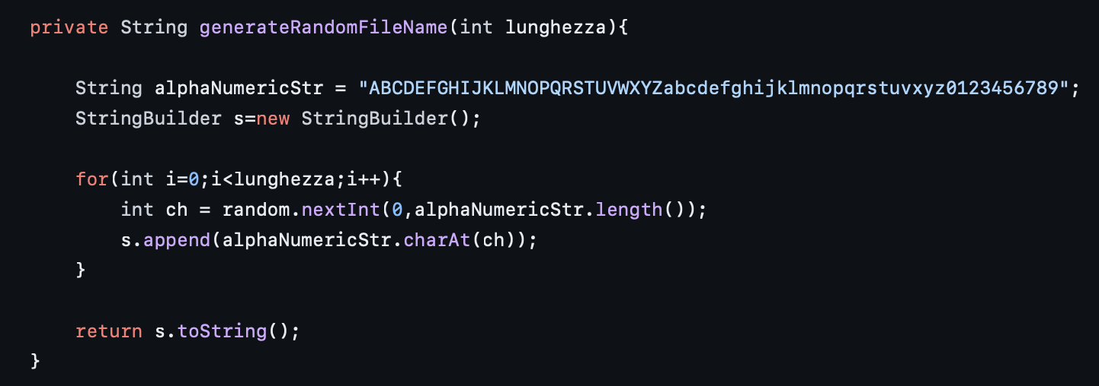
Path-Injection Fix
CI
Notes:
This was solved by ignoring the received file name and generating a random name.

Slide 11
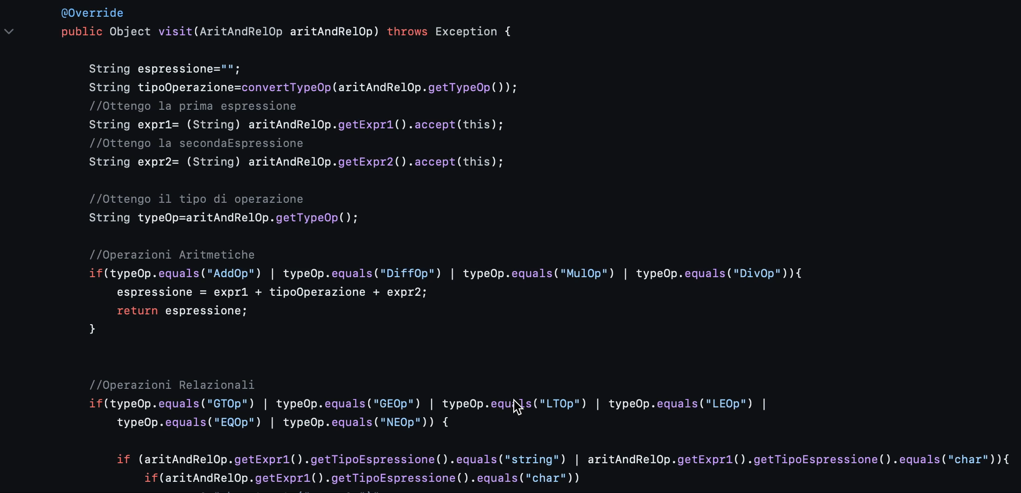
Code Smell Cognitive Complexity
CI
Notes:
For the code smells this an example of a hight cognitive complexity of a method. If we see the flow it is most difficult to understand.

Slide 12
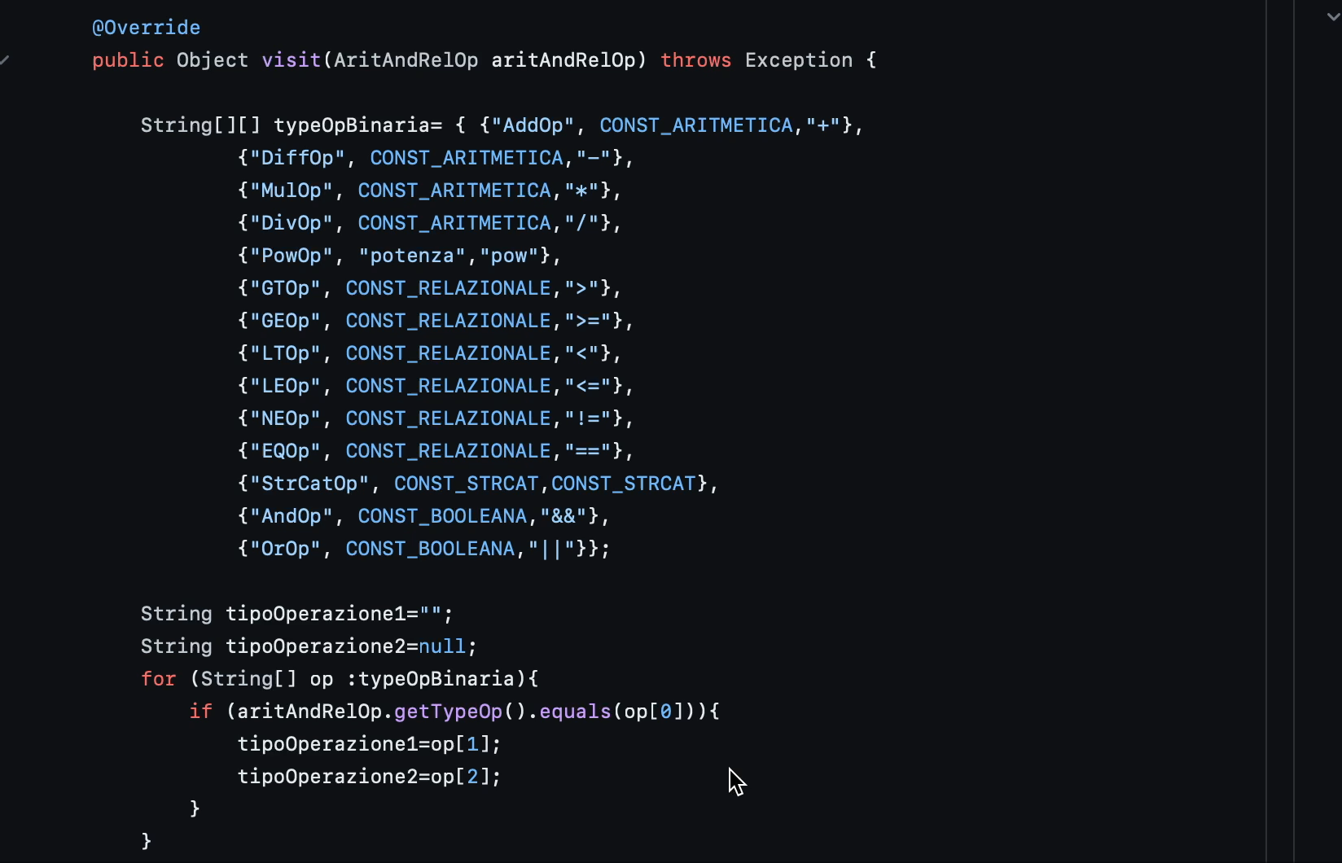
Code Smell Cognitive Complexity Refactoring
CI
Notes:
By simplifying the code and using the extract method technique.

Slide 13


CI
282
545
Issues
0
0
0
282
4
Bugs
4 Vulnerabilities
4
Security Hotspots
533
Code Smells

Slide 14
EcoCode Analysis
CI
Rule | Code Smells | Refactoring
Do not unnecessarily assign values to variables | 274 | Inizialize variable with null
Avoid using global variables | 129 | Use local variable
Avoid multiple if-else statement | 109 | Change if-else with switch
Don’t concatenate Strings in loop, use StringBuilder instead | 35 | Concatenating strings with Sting Builder
Use ++i instead of i++ | 28 | Change i++ with ++i
Avoid the use of For each with Arrays | 12 | Avoid the use of Foreach with Arrays
Initialize builder/buffer with the appropriate size | 9 | Inizialize buffer with size
Avoid getting the size of the col- lection in the loop | 2 | Get size of collection first to iterate on it
Do not call a function when declaring a for-type loop | 2 | Remove function call on declaring for

Slide 15
EcoCode Analysis
CI
Do not unnecessarily assign values to variables
Avoid using global variables
Aoid multiple if-else statement
Don’t concatenate Strings in loop, use StringBuilder instead
600 Issues
Use ++i instead of i++
Avoid the use of For each with Arrays
Initialize builder/buffer with the appropriate size
Avoid getting the size of the collection in the loop
Do not call a function when declaring a for-type loop
Notes:
The ecoCode analysis found 600 code smells, splitted in 9 rules.

Slide 16
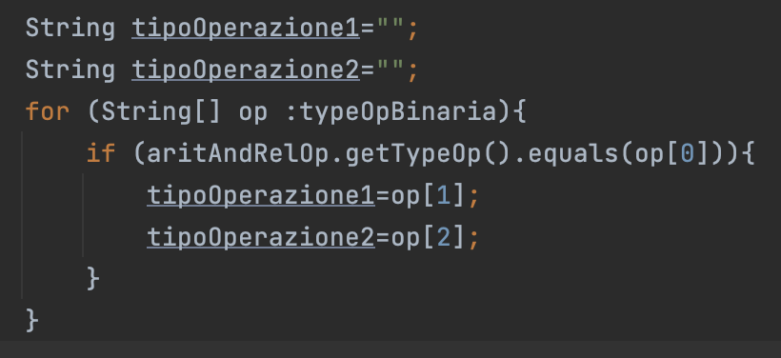
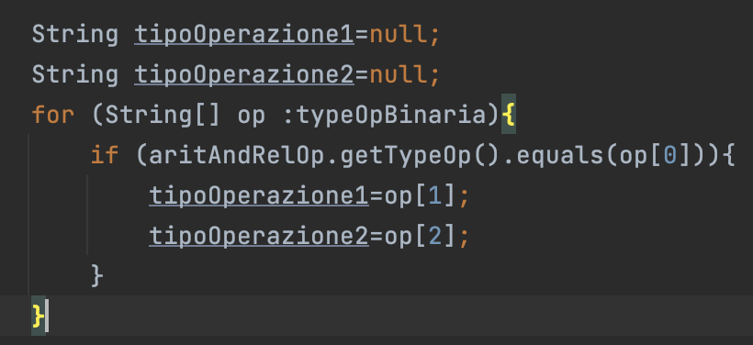
CI
Do not unnecessarily assign values to variables
Code Smell
Avoid using global variables
Aoid multiple if-else statement
Don’t concatenate Strings in loop, use StringBuilder instead
600 Issues
Use ++i instead of i++
Refactoring
Avoid the use of For each with Arrays
Initialize builder/buffer with the appropriate size
Avoid getting the size of the collection in the loop
Do not call a function when declaring a for-type loop
Notes:
For first rule do no unnecessary assigned value to variable, the refactoring applied consist in to inizialize variable with null value.

Slide 17
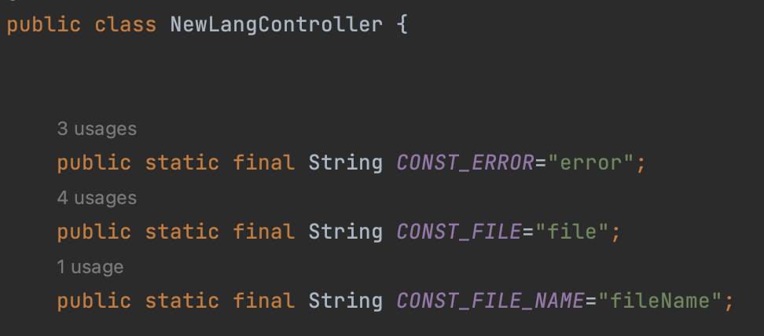
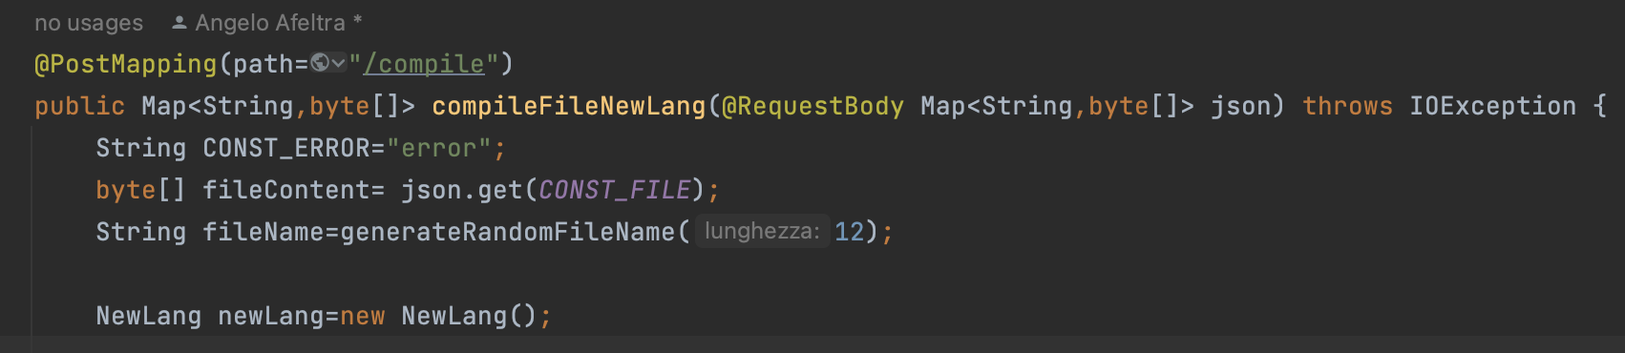
CI
Do not unnecessarily assign values to variables
Code Smell
Avoid using global variables
Aoid multiple if-else statement
Don’t concatenate Strings in loop, use StringBuilder instead
600 Issues
Use ++i instead of i++
Refactoring
Avoid the use of For each with Arrays
Initialize builder/buffer with the appropriate size
Avoid getting the size of the collection in the loop
Do not call a function when declaring a for-type loop
Notes:
For avoid global variable the refactoring is to transform global variable into local variable

Slide 18
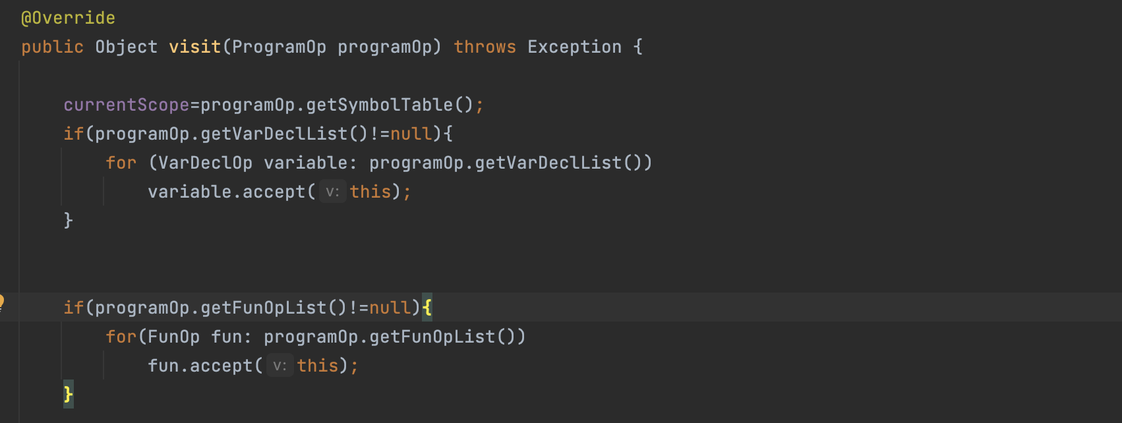
CI
Do not unnecessarily assign values to variables
Avoid using global variables
Code Smell
Aoid multiple if-else statement
Don’t concatenate Strings in loop, use StringBuilder instead
600 Issues
Not Fix
Use ++i instead of i++
Avoid the use of For each with Arrays
Initialize builder/buffer with the appropriate size
Avoid getting the size of the collection in the loop
Do not call a function when declaring a for-type loop
Notes:
For avoid multiple if-esle statement, the refactoring suggested from ecoCode is to change if-else with switch but it wasn’t fix

Slide 19
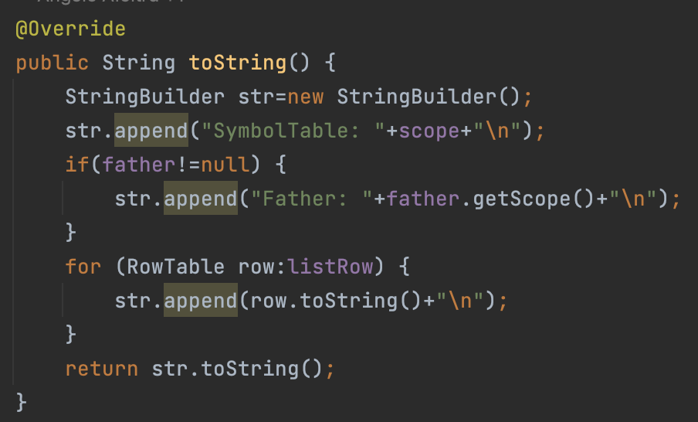
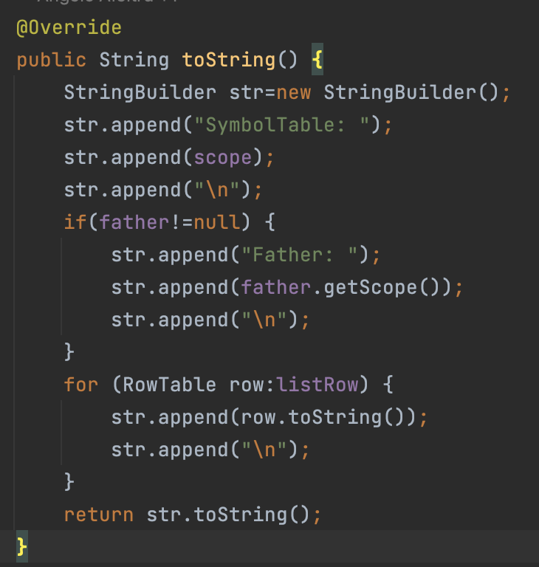
CI
Code Smell
Do not unnecessarily assign values to variables
Avoid using global variables
Aoid multiple if-else statement
Don’t concatenate Strings in loop, use StringBuilder instead
Refactoring
600 Issues
Use ++i instead of i++
Avoid the use of For each with Arrays
Initialize builder/buffer with the appropriate size
Avoid getting the size of the collection in the loop
Do not call a function when declaring a for-type loop
Notes:
For don’t concatena string in loops the refactoring applied is to assembly string with string builder

Slide 20
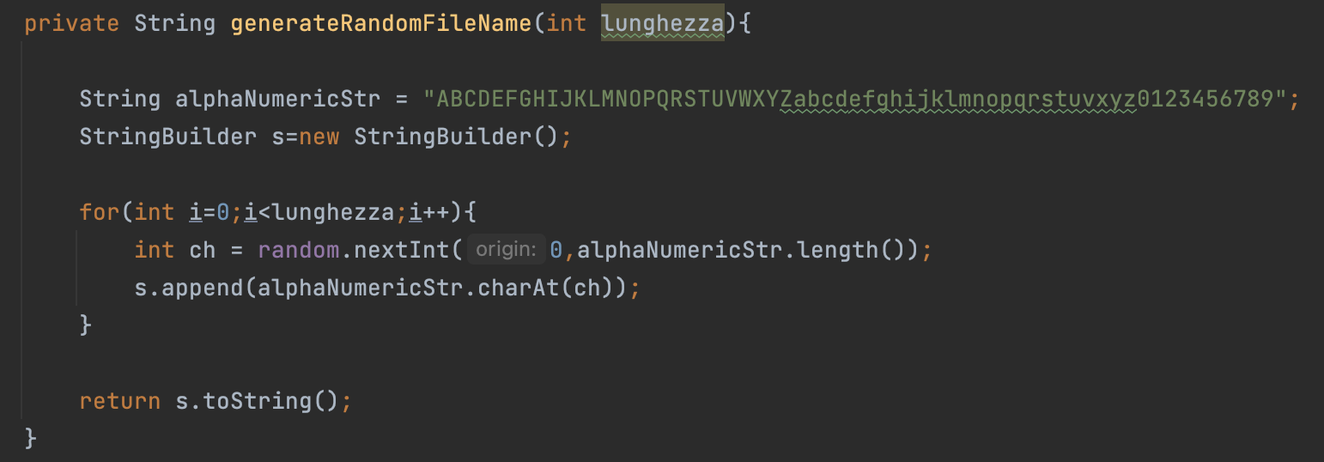
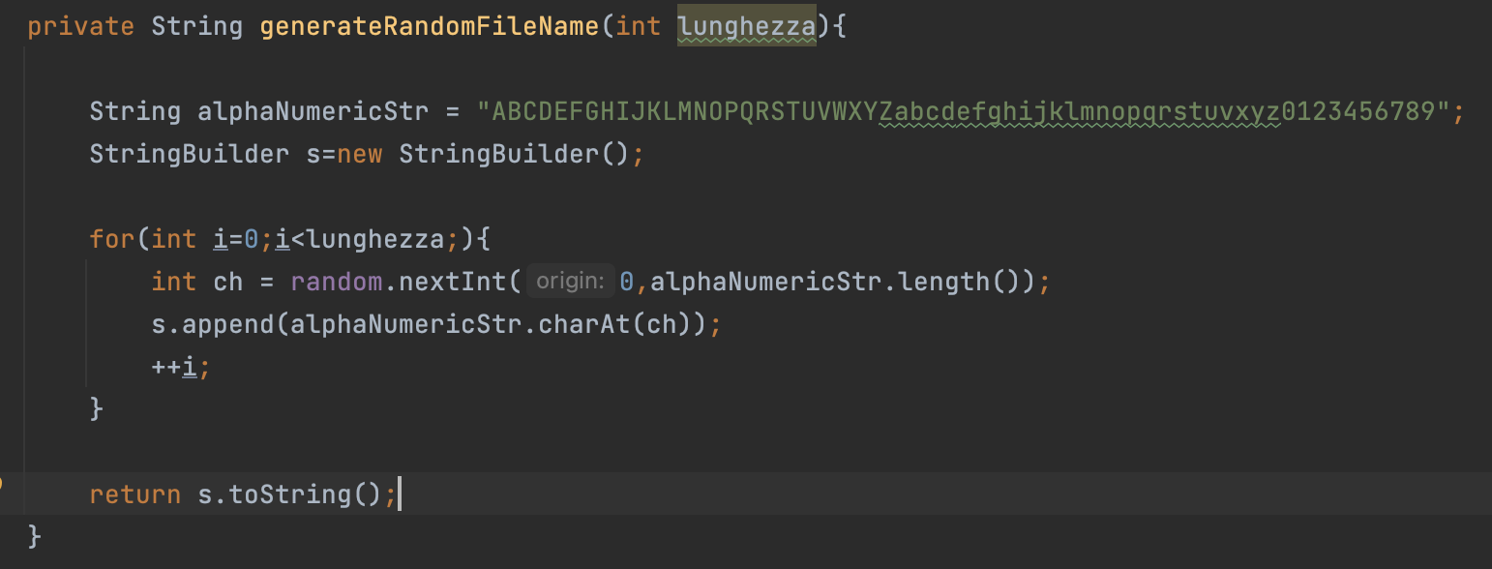
CI
Do not unnecessarily assign values to variables
Code Smell
Avoid using global variables
Aoid multiple if-else statement
Don’t concatenate Strings in loop, use StringBuilder instead
600 Issues
Use ++i instead of i++
Refactoring
Avoid the use of For each with Arrays
Initialize builder/buffer with the appropriate size
Avoid getting the size of the collection in the loop
Do not call a function when declaring a for-type loop

Slide 21
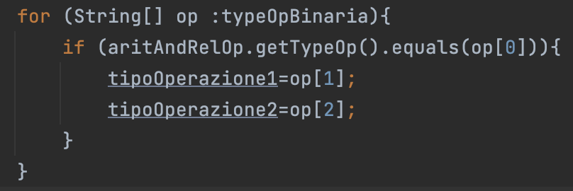
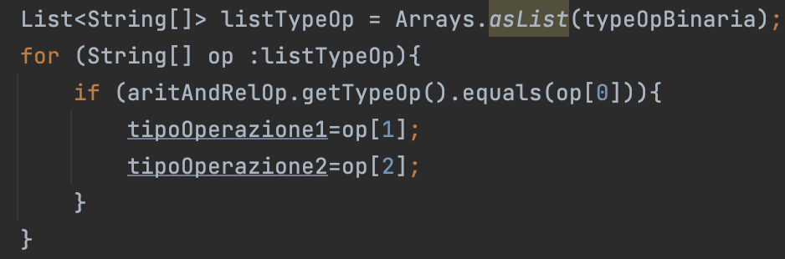
CI
Do not unnecessarily assign values to variables
Code Smell
Avoid using global variables
Aoid multiple if-else statement
Don’t concatenate Strings in loop, use StringBuilder instead
600 Issues
Use ++i instead of i++
Refactoring
Avoid the use of For each with Arrays
Initialize builder/buffer with the appropriate size
Avoid getting the size of the collection in the loop
Do not call a function when declaring a for-type loop
Notes:
For avoid use a for each with array, the refactoring is to convert Array into list and use for each on a list

Slide 22
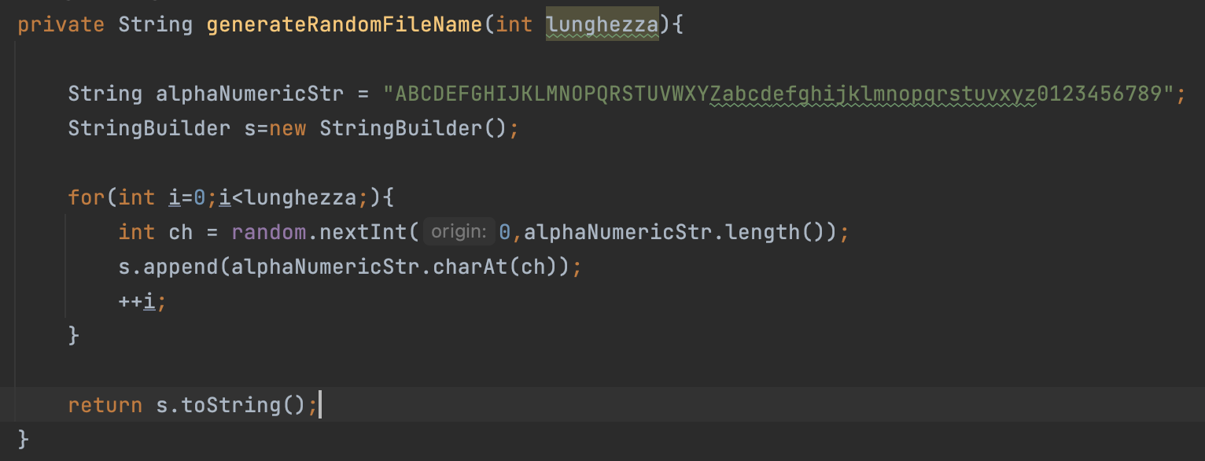
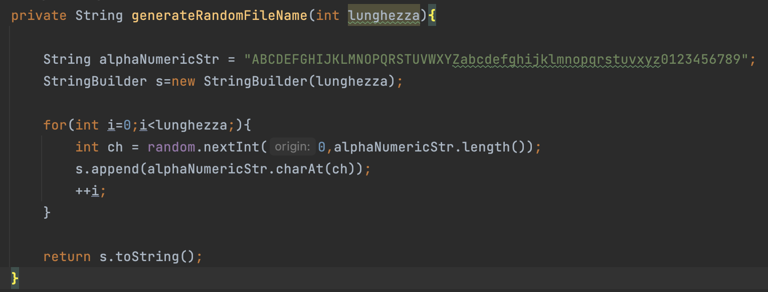
CI
Do not unnecessarily assign values to variables
Code Smell
Avoid using global variables
Aoid multiple if-else statement
Don’t concatenate Strings in loop, use StringBuilder instead
600 Issues
Use ++i instead of i++
Refactoring
Avoid the use of For each with Arrays
Initialize builder/buffer with the appropriate size
Avoid getting the size of the collection in the loop
Do not call a function when declaring a for-type loop
Notes:
For Inizialize builder/buffer with a dim the refactoring is to set a dim at the builder

Slide 23
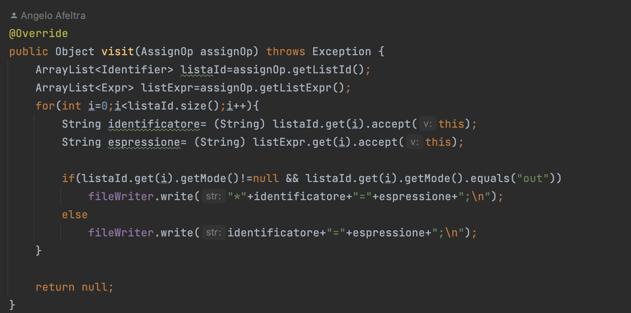
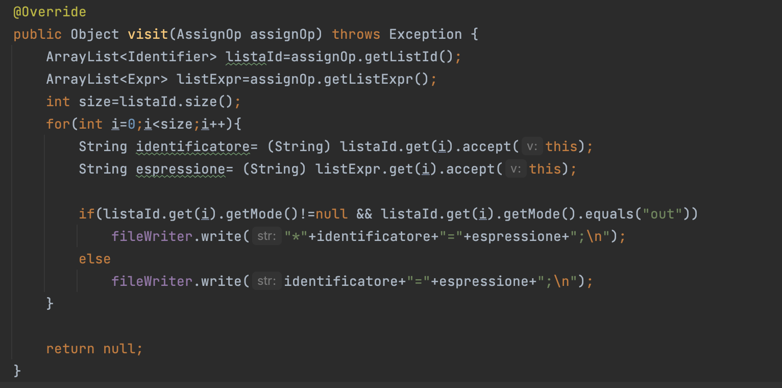
CI
Do not unnecessarily assign values to variables
Code Smell
Avoid using global variables
Aoid multiple if-else statement
Don’t concatenate Strings in loop, use StringBuilder instead
600 Issues
Use ++i instead of i++
Refactoring
Avoid the use of For each with Arrays
Initialize builder/buffer with the appropriate size
Avoid getting the size of the collection in the loop
Do not call a function when declaring a for-type loop
Notes:
For Inizialize builder/buffer with a dim the refactoring is to set a dim at the builder

Slide 24
CI
Do not unnecessarily assign values to variables
Code Smell
Avoid using global variables
Aoid multiple if-else statement
Don’t concatenate Strings in loop, use StringBuilder instead
600 Issues
Use ++i instead of i++
Refactoring
Avoid the use of For each with Arrays
Initialize builder/buffer with the appropriate size
Avoid getting the size of the collection in the loop
Do not call a function when declaring a for-type loop

Slide 25
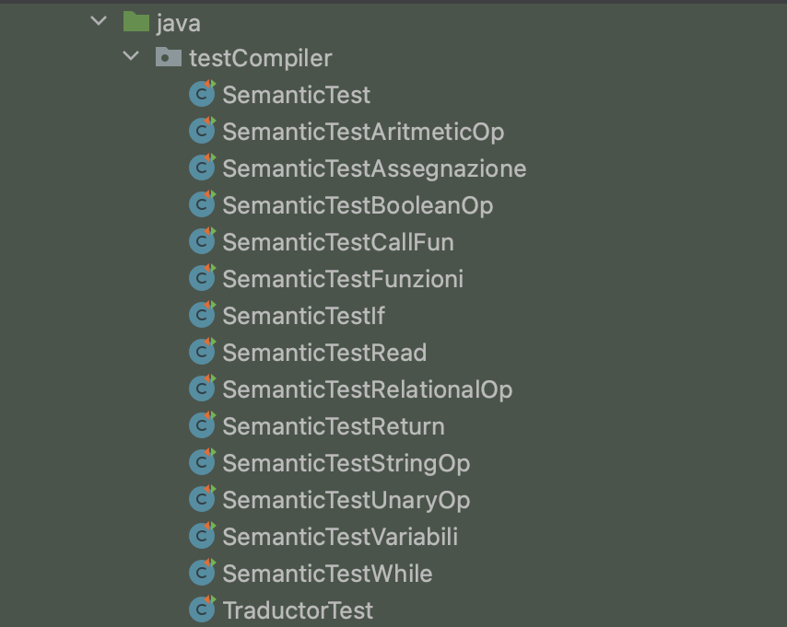
Testing
CI
Notes:
After finishing the code smell analysis phase, the next step was testing. The analysed system already had an existing test suite, but it was not integrated into the Maven build.

Slide 26
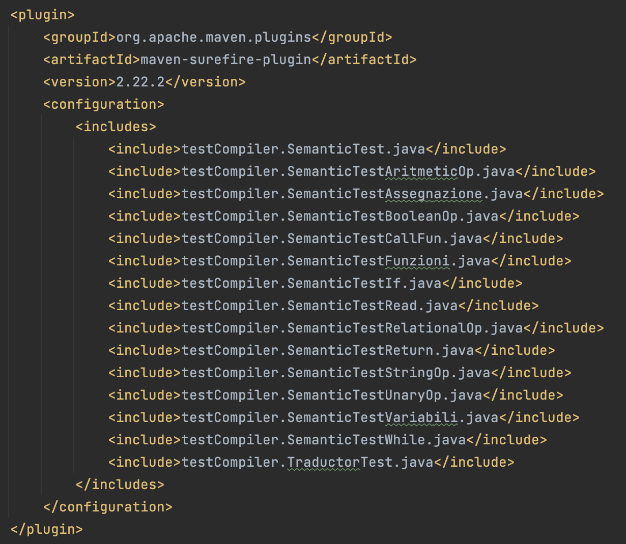
Testing
Start
CI
Add Surfire Plugin
Notes:
Using the Surefire plugin, it was integrated into the build, and thanks to the JaCoCo plugin, the releativecoverage was calculated.

Slide 27
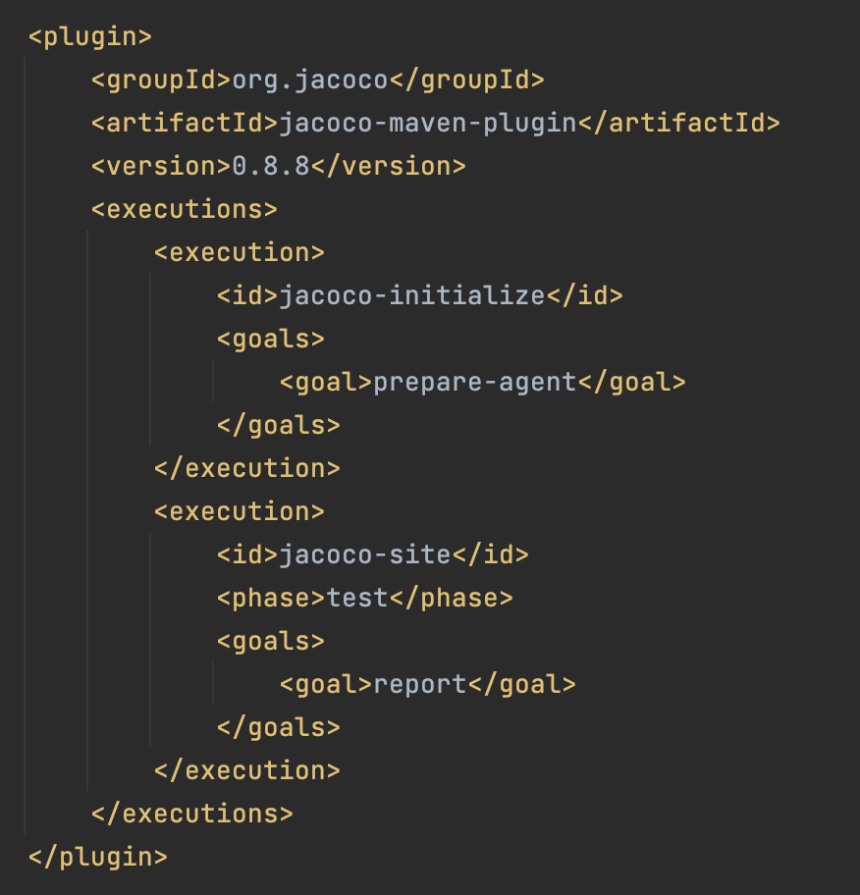
Testing
Start
CI
Add Surfire Plugin
Add JaCoCo Plugin
Notes:
Using the Surefire plugin, it was integrated into the build, and thanks to the JaCoCo plugin, the releative coverage was calculated.

Slide 28
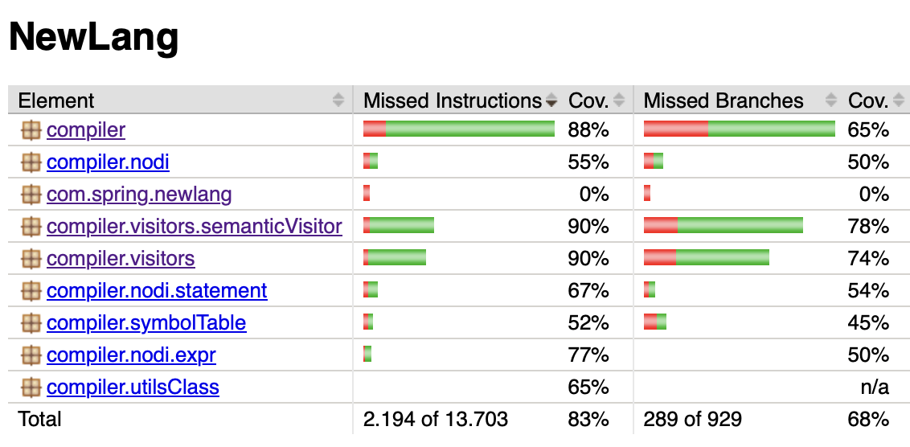
Testing
Start
CI
Add Surfire Plugin
Add JaCoCo Plugin
Code Coverage
Notes:
the statement coverage was 83%, while the branch coverage was 68%.

Slide 29
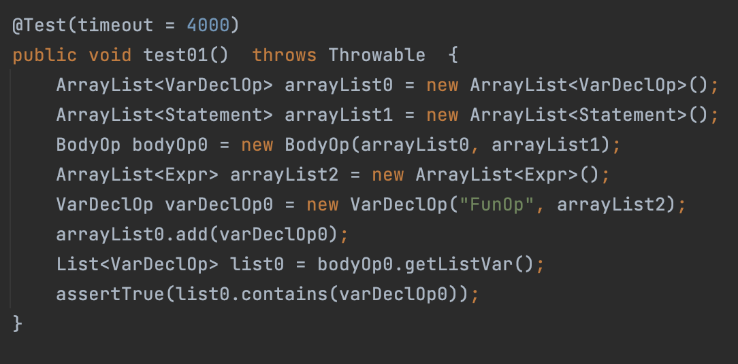
Testing
Start
CI
Add Surfire Plugin
Add JaCoCo Plugin
Code Coverage
Generate Tests
With EvoSuite
Notes:
Using the EvoSuite tool, test cases were generated automatically; this is an example of a generated test

Slide 30
Testing
Start
CI
Add Surfire Plugin
Add JaCoCo Plugin
Code Coverage
Generate Tests
With EvoSuite
Add Tests Into Test Suite

Slide 31
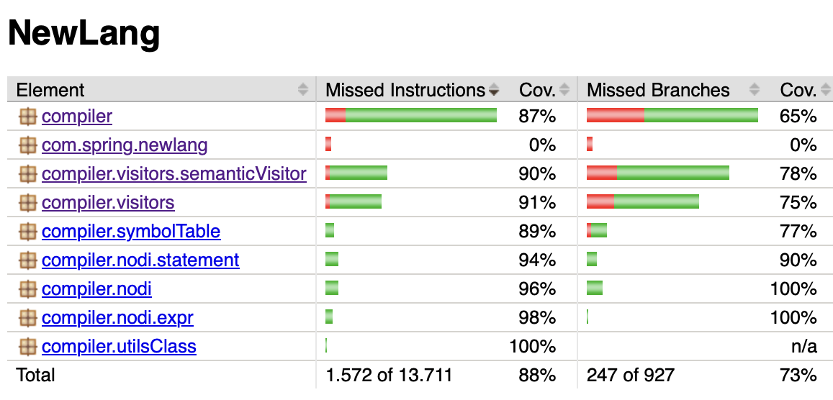
Testing
Start
CI
Add Surfire Plugin
Add JaCoCo Plugin
Code Coverage
Generate Tests
With EvoSuite
Add Tests Into Test Suite
Code Coverage
End
Notes:
These tests were added to the existing tests suite, and the coverage increase to 88% and 73%.

Slide 32
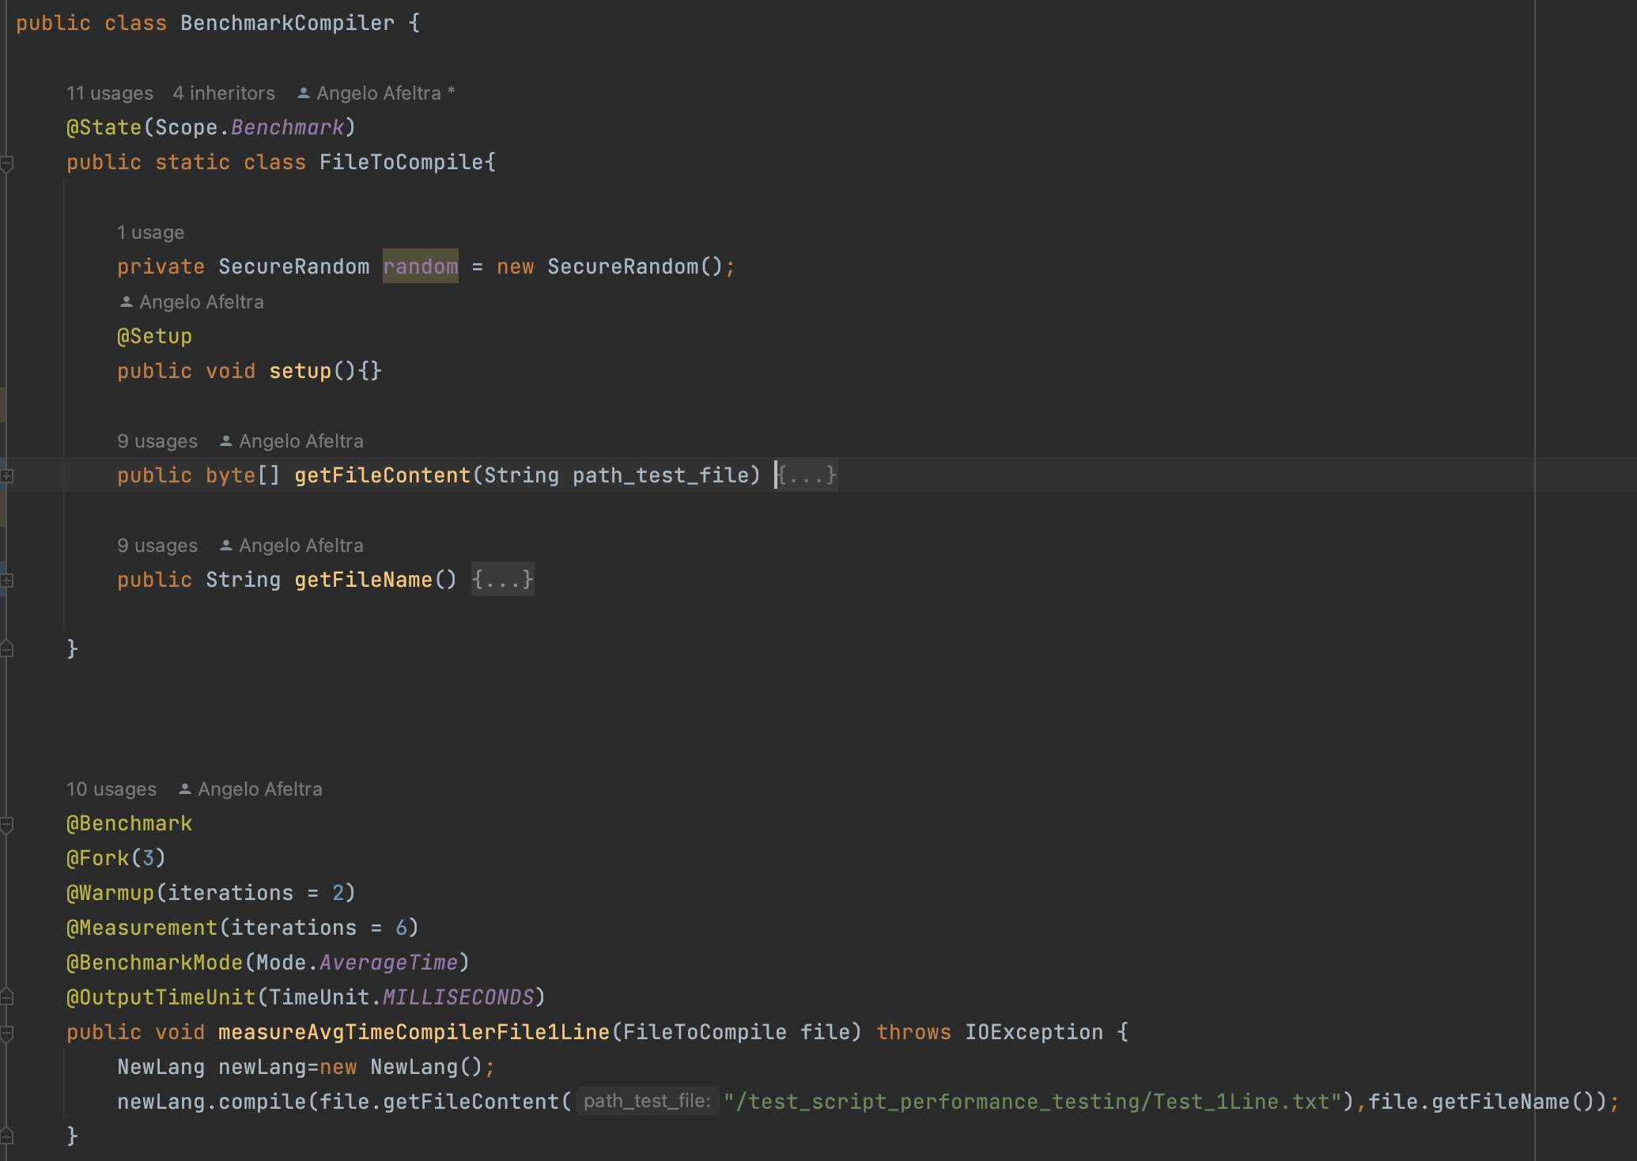
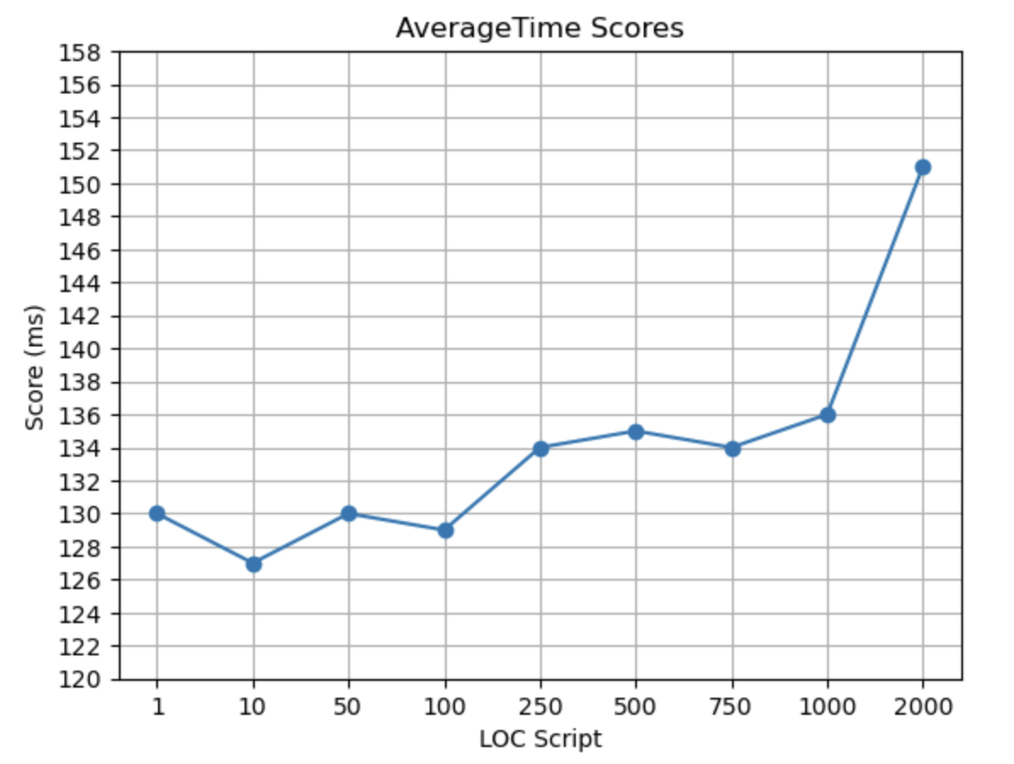
Performance Testing
CI
Microbenchmark method
Notes:
Another test conducted was performance testing in order to understand the system's response under different workloads. Using JMH, a microbenchmark method was created for the compile() method.

Slide 33



Security Analysis
CI
FindSecBugs
OWASP DC
OWASP ZAP
Notes:
For the security analysis three tool were used, FindSecBugs, OWASP DC and OWASP ZAP.

Slide 34
CI
FindSecBugs
Malicious code vulnerability Warnings (92)
Security Warnings
(4)
Dodgy code Warnings (15)

Slide 35
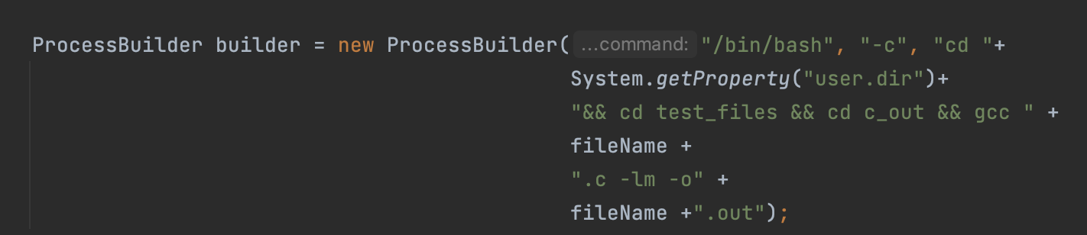
CI
FindSecBugs
Malicious code vulnerability Warnings (92)
Security Warnings
(4)
Dodgy code Warnings (15)
Command Injection
CRLF Injection
Path Traversal
Notes:
FindSecBugs detected 111 warnings, of which 4 are Security Warnings about command-injection, CRLF Injection and Path Traversal.

Slide 36
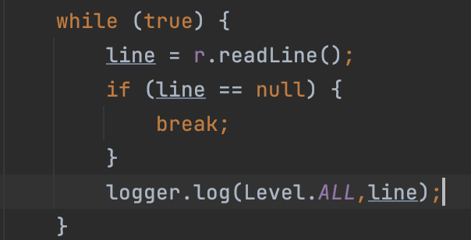
CI
FindSecBugs
Malicious code vulnerability Warnings (92)
Security Warnings
(4)
Dodgy code Warnings (15)
Command Injection
CRLF Injection
Path Traversal

Slide 37
CI
FindSecBugs
Malicious code vulnerability Warnings (92)
Security Warnings
(4)
Dodgy code Warnings (15)
Command Injection
CRLF Injection
Path Traversal

Slide 38
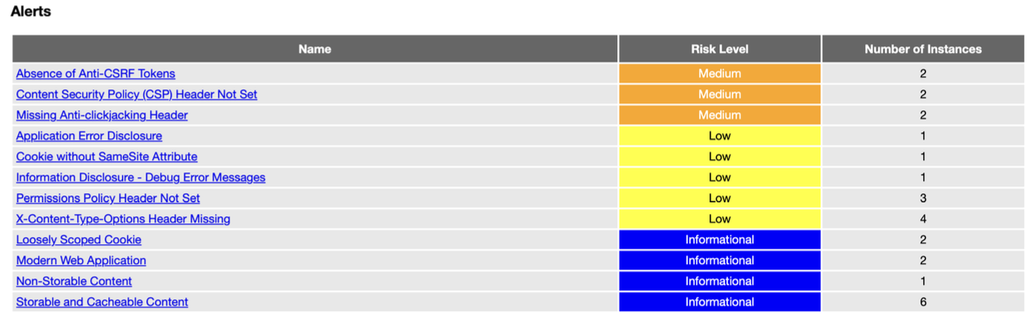
CI
OWASP ZAP
Notes:
OWASP DC did not detect any warnings, and OWASP ZAP detected 12 alert.

Slide 39
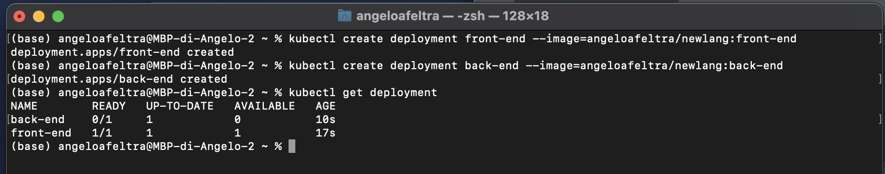
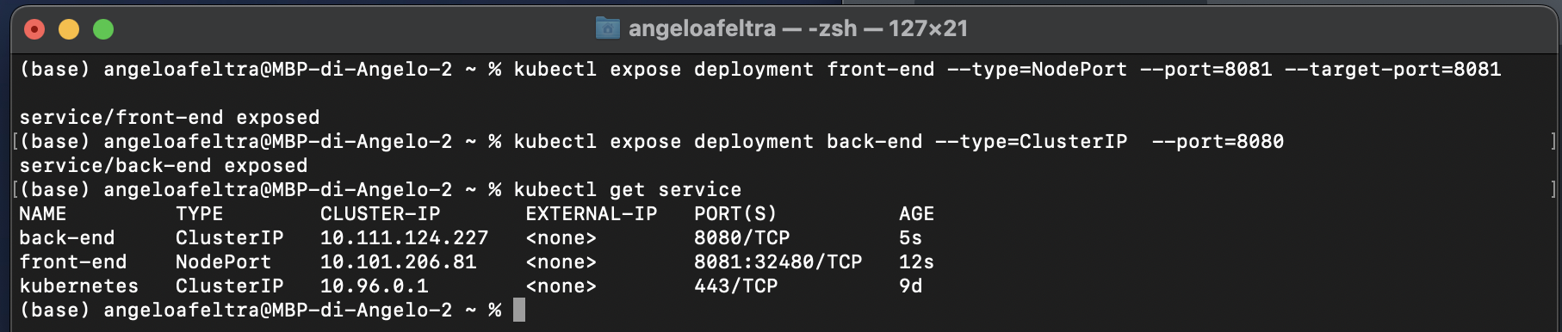
Kubernetes Simulation
CI
Minikube Start
Minikube Service Front-end
Notes:
Having containerised the system, it was also possible to simulate the use of kubernetes. Using Minikube, a local kubernetes environment similar to a real one was simulated.
With the command kubectl create deployment, two deployments were created based on the front-end and back-end image.
With the kubectl expose command, two services for the deployment were created and with the Minikube service front-end command, it was possible to connect to the system.

Slide 40
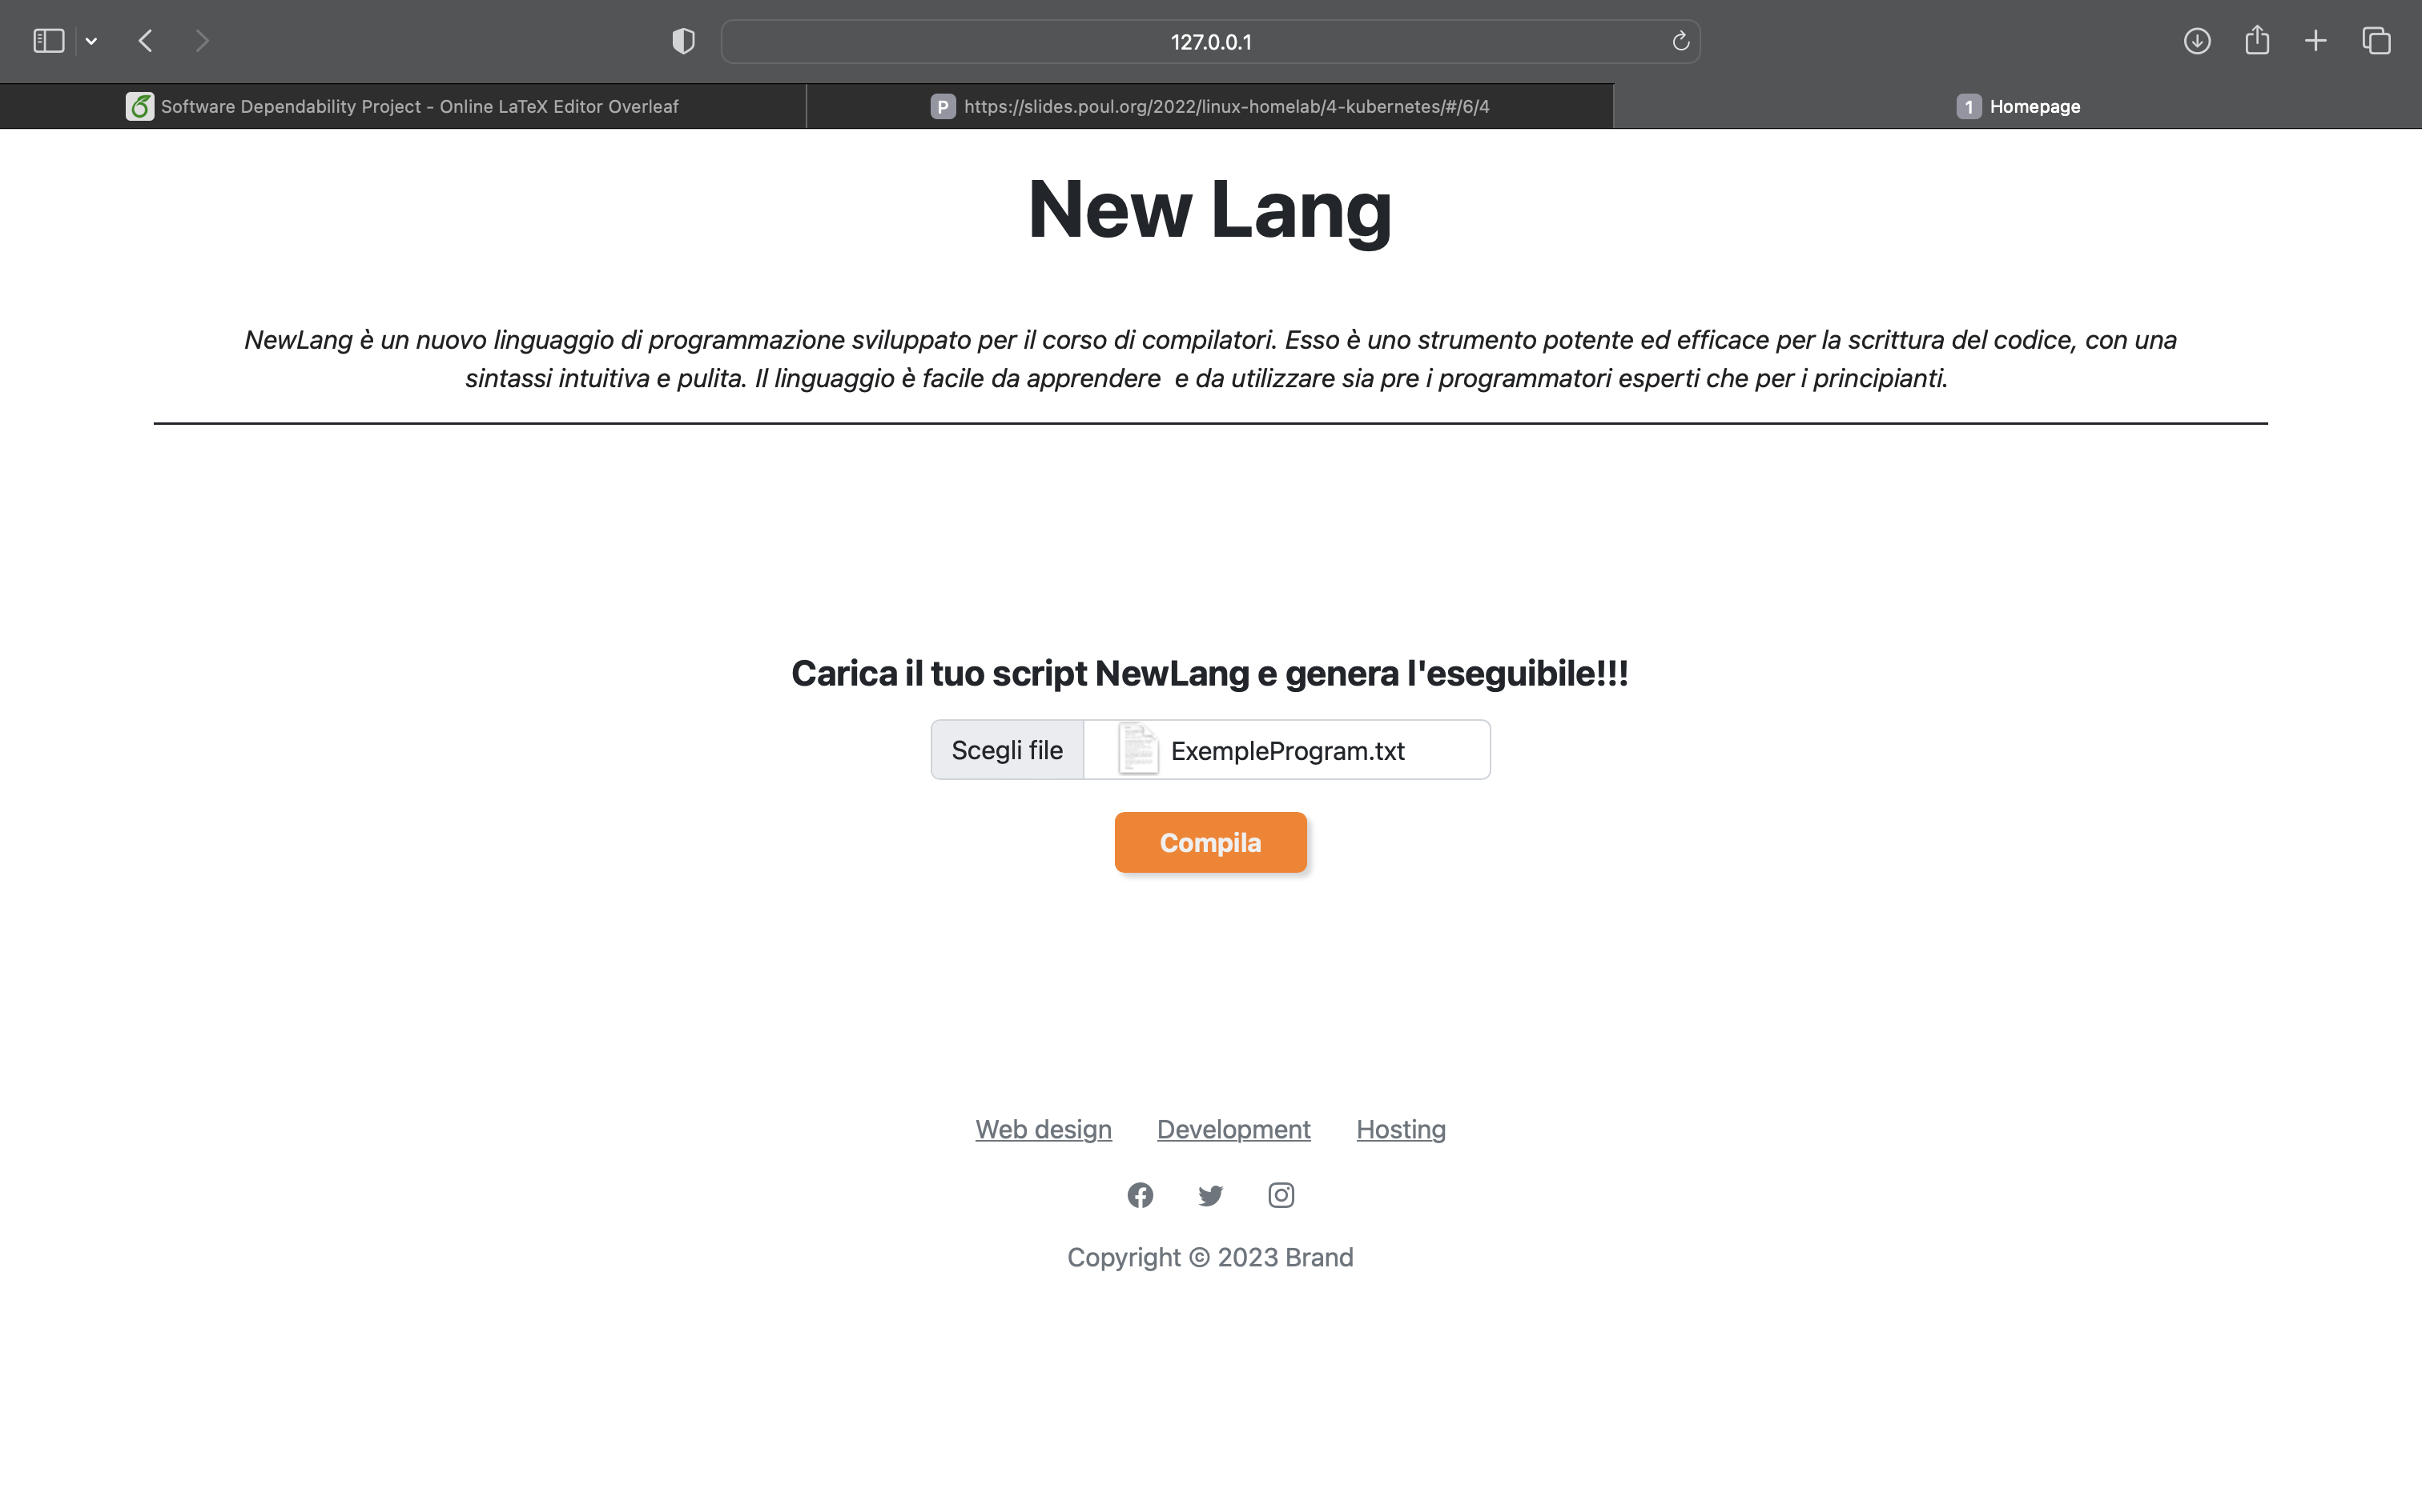
CI
Notes:
This is the script upload page

Slide 41
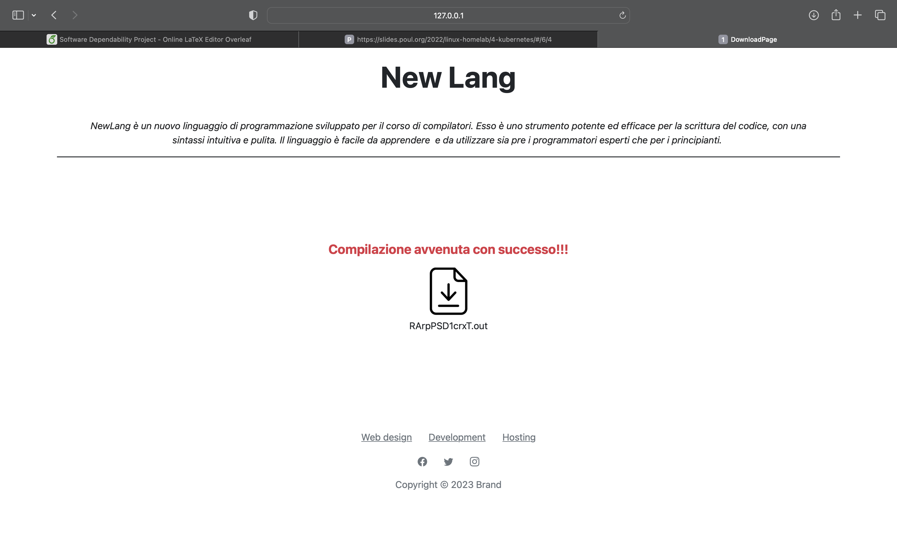
CI
Notes:
this is a script compiled.

Slide 42
?
Thank you for your attention.
Student:
Angelo Afeltra
Teacher:
Prof. Dario Di Nucci

